Slide 1



Distributed Insomnia
When systems must never sleep
Mariusz Krzanowski
Solutions Architect, MR Matrix
MAIN ORGANIZER:
ORGANIZING COMMITTEE: dozens of organizations from the IT / data science sector (full list on the event website

Slide 2


About Me
Employed in IT since 0x7CF
Developer / Solutions Architect / Team Leader
Experienced in many technologies
.NET, SQL, Azure, Android, Kubernetes, SharePoint, BizTalk, SCCM, Active Directory, Web Development …
I like to share my knowledge with others
You can meet me at
Warszawska Grupa .NET (WG-NET)
Warszawskie Dni Informatyki

Slide 3
Purpose
To help us in designing reliable systems
I see the same design errors repeated nonstop
To enjoy our live when our system is on production
To focus on development and release management process
Infrastructure is covered in multiple conferences’ talks already

Slide 4
‘Nines’ availability
Daily downtime
99.00% = 14 minutes 24 seconds
99.90% = 1 minute 26 seconds
99.99 % = 8.6 seconds
How much we can reserve for our software ?

Slide 5
‘Nines’ availability
Daily downtime
99.00% = 14 minutes 24 seconds
99.90% = 1 minute 26 seconds
99.99 % = 8.6 seconds
How much we can reserve for our software ?
0 – ZERO!

Slide 6
Infrastructure vs Software
Infrastructure failure

Slide 7

Infrastructure vs Software

Slide 8
Infrastructure vs Software

Slide 9
Infrastructure vs Software

Slide 10
Infrastructure vs Software

Slide 11
Infrastructure vs Software

Slide 12
Infrastructure vs Software

Slide 13
Infrastructure vs Software
Conclusion
Replicated infrastructure increases resiliency

Slide 14
Infrastructure vs Software
Conclusion
Replicated infrastructure increases resiliency
What about software?

Slide 15
Infrastructure vs Software

Slide 16

Infrastructure vs Software

Slide 17
Infrastructure vs Software

Slide 18
Infrastructure vs Software
Conclusion
Replicated infrastructure increases resiliency
Software tests are more critical because broken copy means disaster

Slide 19

End user does not care
Reliability must be focused on user facing parts
Retries on browser level
Predict what user does next
Background processes can be less reliable
Business must decide what is critical
Creating highly available software is expensive!

Slide 20


Automation
Continuous integration
Automated tests
Unit tests
Integration tests
Load tests
Canary testing
Feature toggles
Continues delivery
Automatic rollback strategy
Metrics

Slide 21

Redundancy everywhere
Connection Strings
Note that Azure exposes primary and secondary keys
Datacenters
Databases
Use read replicas
Scaling database can disconnect your process
IP Addresses/DNS (paranoic mode)

Slide 22

Health metrics
Is our process available?
When we are overloaded report it to supervisor
Is our process healthy?
Our process must report resources inaccessibility

Slide 23

Cache is your friend
On server
On CDN (Content Delivery Network)
On client
Zero network downtime to access local cache
Less traffic higher availability

Slide 24
Read models
Render once – deliver multiple times
Many independent replicas
Hot and cold storage
Key values stores are faster than database

Slide 25

No singletons
Single HTTP call can be replicated
See circuit breakers
Idempotency key
Distributed locks / session's support
Only for background jobs
Prefer optimistic over pessimistic lock
Infrastructure blue/green deployment
Be aware of single background jobs

Slide 26
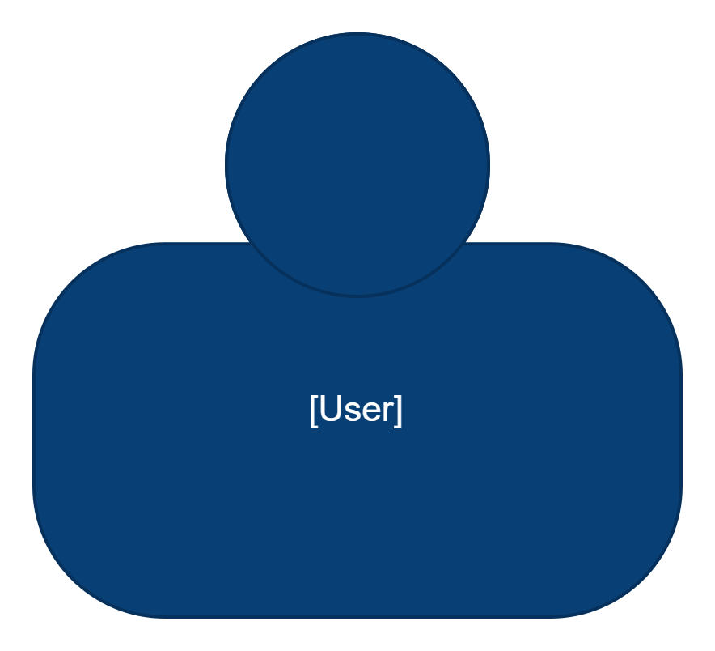
New release
Database migration
UI → BFF → APP → Database
Multi-versions
UI
BFF
APP
DB

Slide 27
New release
We must be sure that
all User Interfaces are upgraded !!!
UI
V1
V2
V2
V2
V1
V1
V2
V2
BFF
V1
V2
V1
V1
V2
V1
V2
V2
APP
V1
V1
V2
DB
V2
V1
V1
V2
V1
time

Slide 28
Pre and post database migration
BONUS
Database premigration
Prepare database for new version of application
Application upgrade
Database post migration
Remove structure required by older version
Possible problems with
infrastructure blue green
deployment !!!

Slide 29
Blue green read models
BONUS
Create new read model structure
Feed newly created read model with data
Switch application to new read model when it is in sync

Slide 30
Summary
Reliable infrastructure does guarantee reliable software
Testing software is critical
Automate all you can
Reliability means coexistence of multiple versions
Prepare your code for infrastructure update
Each request can be delivered at leas once
Focus on customer facing parts

Slide 31

Where can you find me?
Web
https://lastboardingcall.pl
https://mrmatrix.net
GitHub
https://github.com/MariuszKrzanowski
YouTube
Mariusz Krzanowski `mrmatrix.net`
Tweeter
@KrzanowskiM
Meetups
Warszawska Grupa .NET
Mariusz Krzanowski

Slide 32

Thank you for watching!
Remember to rate the presentation and
leave your questions in the section below.
www.WarszawskieDniInformatyki.pl
31 March - 1 April 2023
Politechnika Warszawska + online
MAIN ORGANIZER:
ORGANIZING COMMITTEE: dozens of organizations from the IT / data science sector (full list on the event website

